Slide 1


Bootcamp Day-3
by ThinkCloudly

Slide 2
Agenda...
Revisiting previous topics
Minikube installation
K8s kubectl commands

Slide 3
Revisiting: What is Kubernetes ???
Container ‘Orchestrator’
Open-source project
k8s
DevOps tool

Slide 4
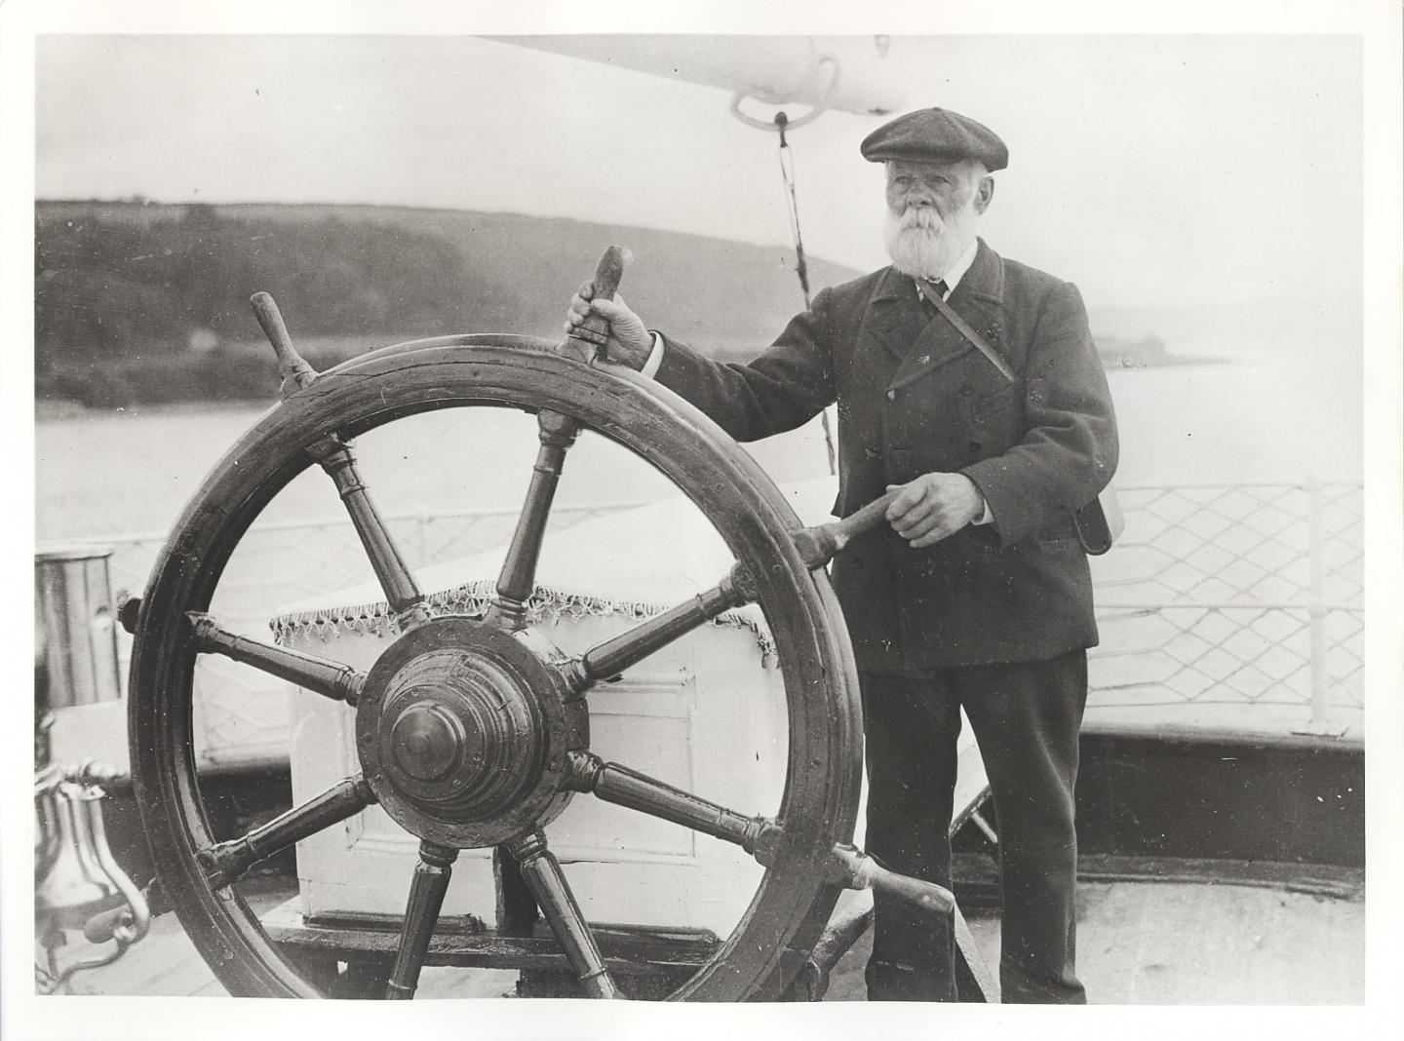
Revisiting: Icon looks similar to…

Slide 5
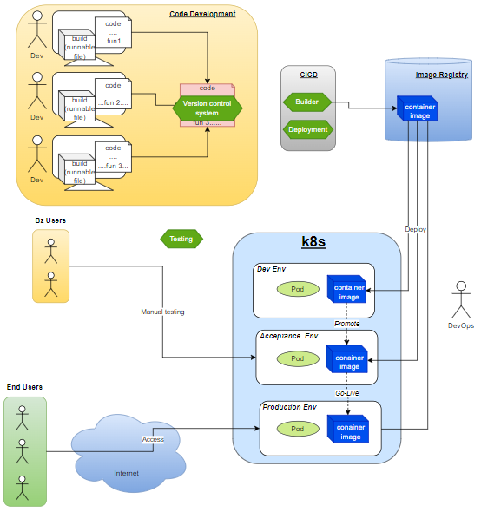
Revisiting: K8s in the ecosystem

Slide 6
Revisiting: Why k8s
Widely used in IT
Container runtime agnostic
Follow declarative configuration
Multi-cloud capability
Enhances productivity
Portable and flexible
Free and open source

Slide 7
Revisiting: Key terms
Pod
Node (worker, master)
Cluster
Namespace
kubectl (cli)
Service
Deployment

Slide 8
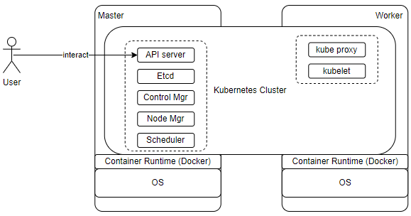
Revisiting: k8s Architecture

Slide 9
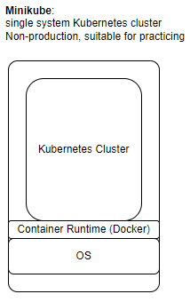
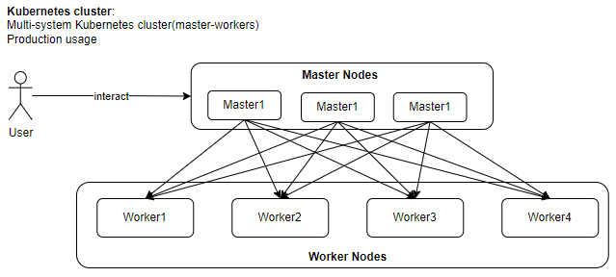
Revisiting: Production setup & Minikube

Slide 10
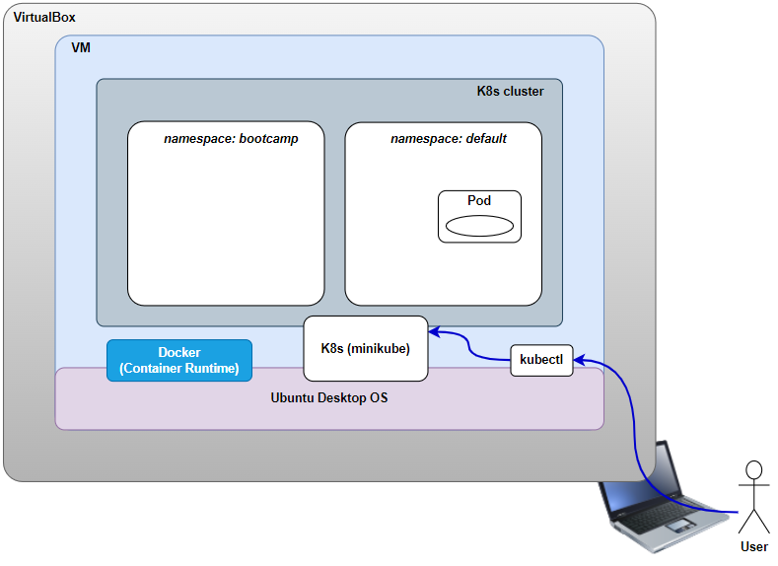
Minikube installation

Slide 11
Thank You….

